Slide 1
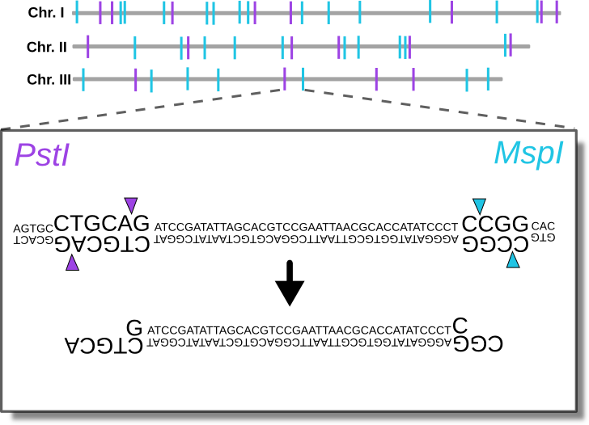
Lab 12: Introduction to RADseq data
BIOL4174/5174 Conservation Genetics Spring 2018

Slide 2
outline
NGS- why reduced-representation
Targeted enrichment vs RADseq
Overview of ddRAD
Overview of Illumina
Potential problems:
Overclustering
Conflicting fluorescence within clusters
Evaluating in FASTQC
Assembling RADseq data: ipyrad
Quality filtering
Clustering within individuals
Catalog generation
Clustering among individuals
Etc.

Slide 3
Next-generation sequencing
Millions of sequences at $0.05 per million bases
Can sequence entire genomes
Whole-genome sequencing often too expensive for population-level (hundreds, thousands of individuals)

Slide 4
Reduced-representation sequencing
To be useful at the population-level, need to reduce the genome consistently across individuals
Most common methods:
Restriction-site Associated DNA sequencing (RADseq)
Targeted enrichment methods

Slide 5
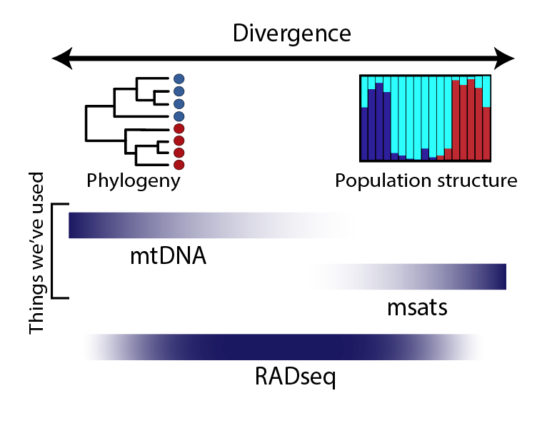

Slide 6
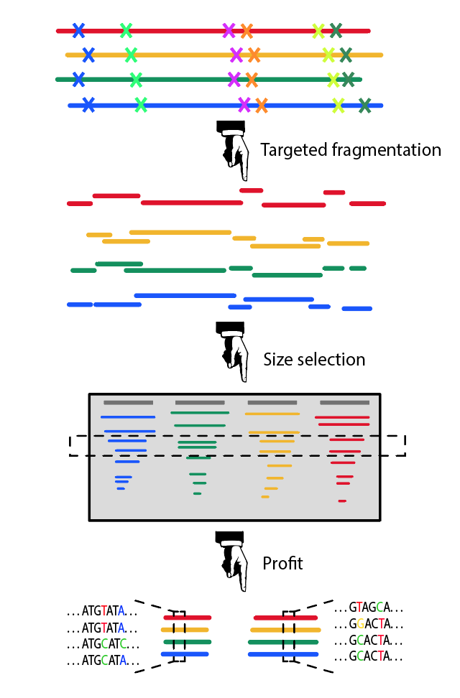
RAD-seq

Slide 7
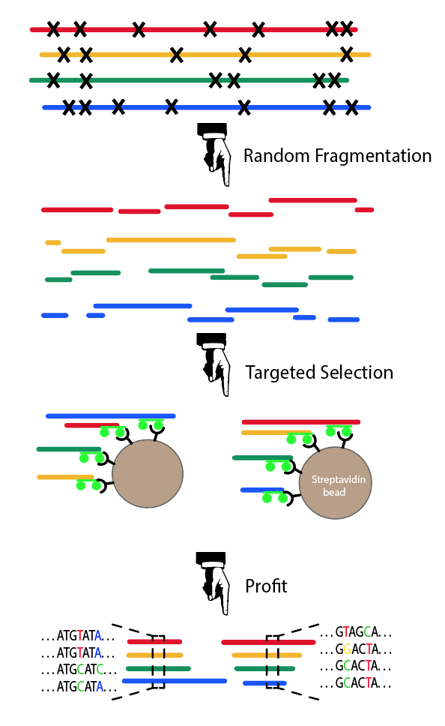
RAD-seq
Targeted Enrichment

Slide 8
1. Digest genomic DNA with paired restriction enzymes
Double-digest RADseq

Slide 9
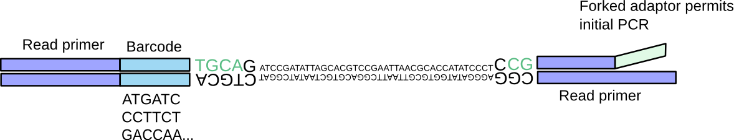
2. Ligation of barcoded adaptors
Double-digest RADseq
Barcoded samples can then be pooled

Slide 10
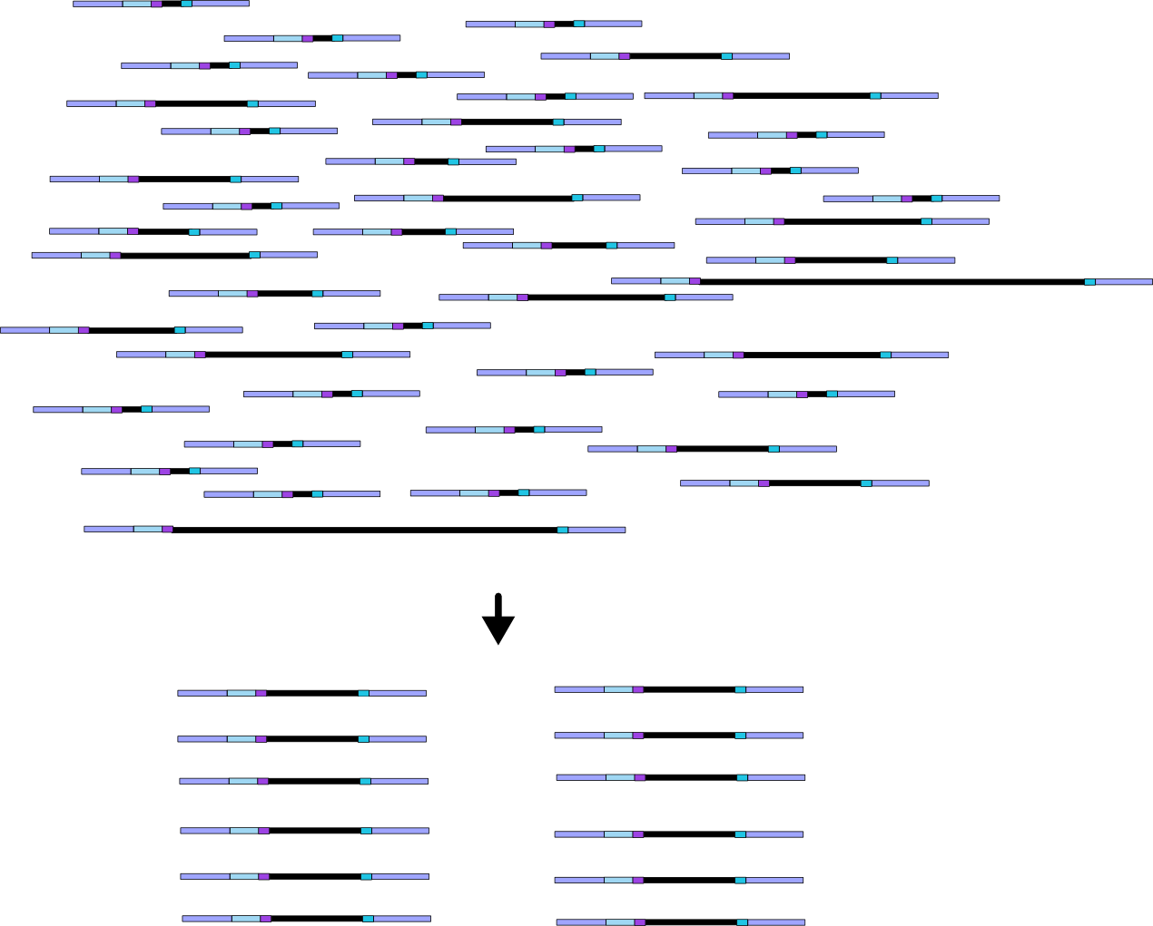
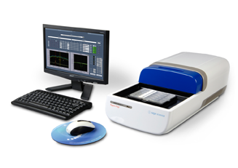
3. Size selection of digested fragments
Double-digest RADseq

Slide 11
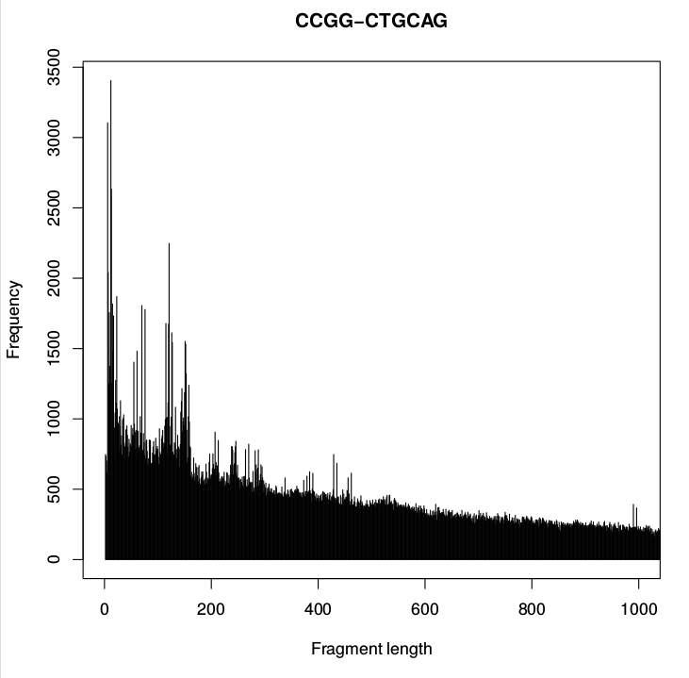
3. Size selection of digested fragments
Double-digest RADseq
Size range manipulated to target specific # of loci

Slide 12
3. Size selection of digested fragments
Double-digest RADseq
Size range manipulated to target specific # of loci

Slide 13
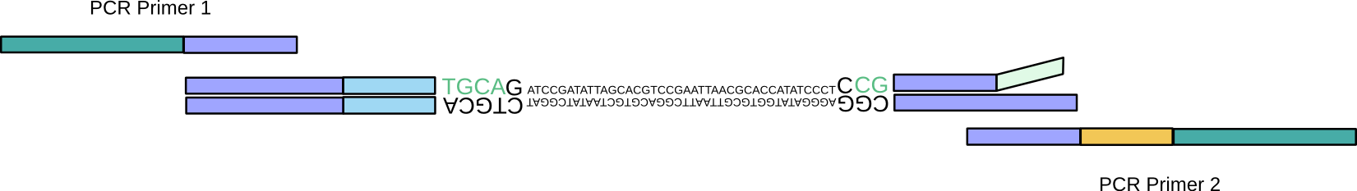
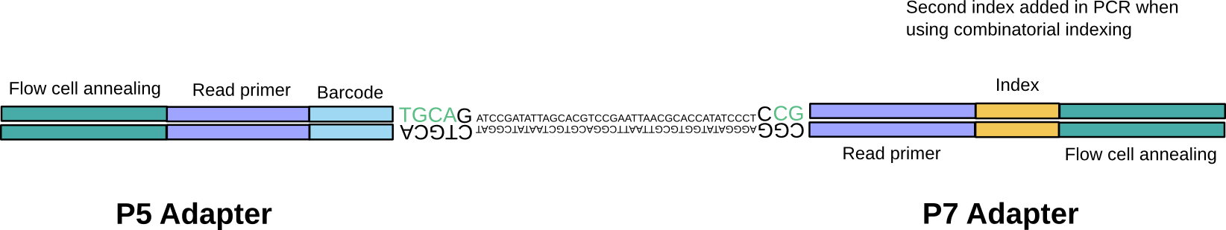
4. Adaptor extension by PCR
Double-digest RADseq

Slide 14
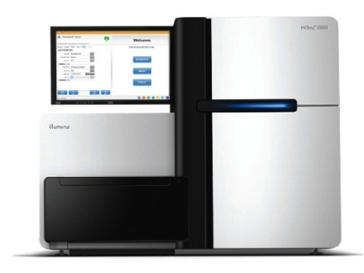
Final library
Double-digest RADseq
P5-P5 and P7-P7 fragments fail bridge amplification and are not sequenced

Slide 15
Illumina Sequencing

